Slide 1


Umer Sherdil Paracha
13.07.2022

Slide 2

Outline
Executive Summary
Introduction
Methodology
Results
Conclusion
Appendix

Slide 3
Executive Summary
Summary of methodologies
Data Collection
Data Wrangling
EDA with Data Visualization
EDA with SQL
Interactive Map using Folium
Dashboard using Plotly Dash
Predictive Analysis (Classification)
Summary of all results
EDA Results
Interactive Analysis
Predictive Analysis

Slide 4
Introduction
Space X advertises Falcon 9 rocket launches on its website with a cost of 62 million dollars; other providers cost upward of 165 million dollars each, much of the savings is because Space X can reuse the first stage.
The aim of the analysis is to predict if the landing of the first stage rocket.

Slide 5

Section 1

Slide 6
Methodology
Executive Summary
Data collection methodology:
Data collected through SpaceX REST API and Web Scrapping from Wikipedia.
Perform data wrangling
Exploratory data analysis performed using pandas.
Perform exploratory data analysis (EDA) using visualization and SQL
Perform interactive visual analytics using Folium and Plotly Dash
Perform predictive analysis using classification models
Models built, tuned and evaluated using sklearn (Logistic Regression, SVM, Decision Trees, K-Nearest Neighbors).

Slide 7
Data Collection
Datasets collected using SpaceX API and Web Scrapping from Wikipedia.
API provides data about launches. For example, the type of rocket used, payload delivered, launch and landing specifications and landing outcome.
Web Scrapping from Wikipedia tables was done using Beautiful Soup.

Slide 8
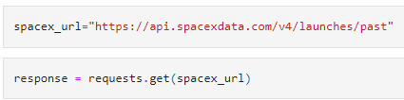
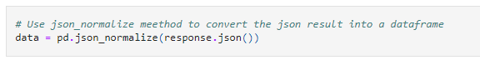
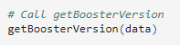
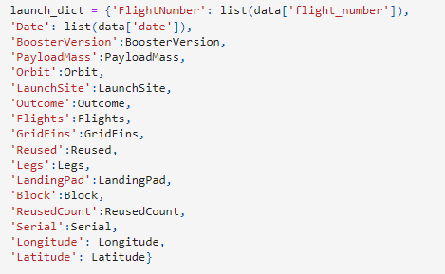
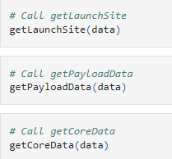
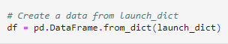
Data Collection – SpaceX API
Using get method to retrieve data from API.
Converting data to JSON.
Helper functions to fetch useful data from API.
Creating a Python dictionary.
Creating Pandas Dataframe.
Data_Science_and_ML/jupyter-labs-spacex-data-collection-api.ipynb at main · UmerSherdil/Data_Science_and_ML (github.com)
1
2
3
4
5

Slide 9
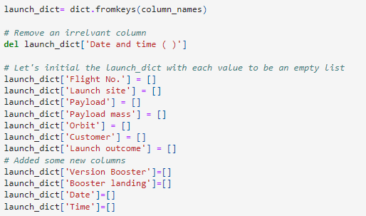
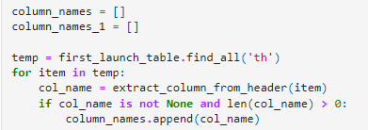
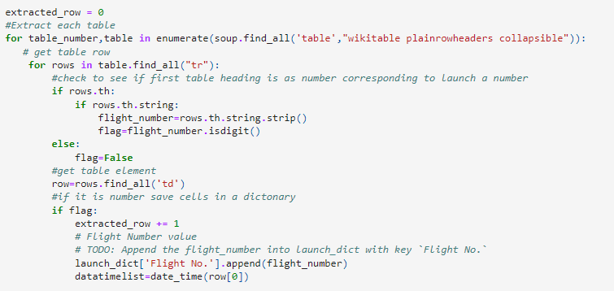
Data Collection - Scraping
Using get method to retrieve data from HTML.
Creating BeautifulSoup object.
Finding all tables.
Extracting column names.
Preparing dictionary
Filling dictionary with values from table.
Creating Dataframe
Data_Science_and_ML/jupyter-labs-webscraping.ipynb at main · UmerSherdil/Data_Science_and_ML (github.com)
1
2
3
5
4
6
7

Slide 10
Check null values
Calculate launches per Site
Calculate number and occurence of each orbit.
Calculate the number and occurence of mission outcome per orbit type
Calculate the number and occurence of mission outcome per orbit type
Filling missing values
Data Wrangling
Data_Science_and_ML/labs-jupyter-spacex-Data wrangling.ipynb at main · UmerSherdil/Data_Science_and_ML (github.com)

Slide 11
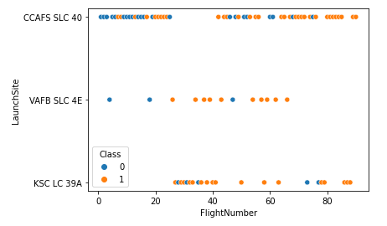
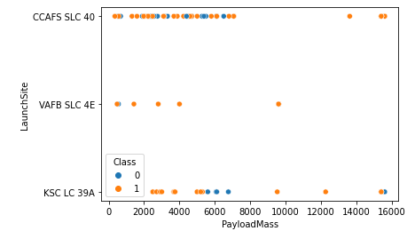
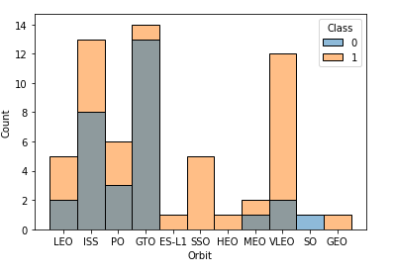
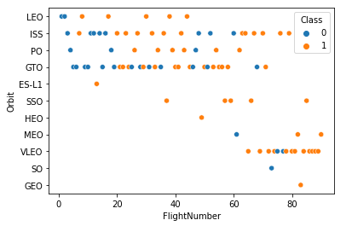
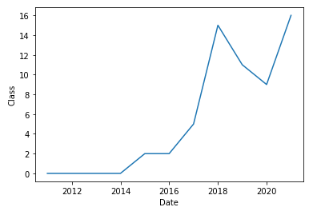
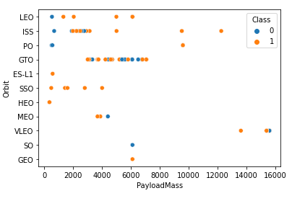
EDA with Data Visualization
Data_Science_and_ML/jupyter-labs-eda-dataviz.ipynb at main · UmerSherdil/Data_Science_and_ML (github.com)

Slide 12
EDA with SQL
Display the names of the unique launch sites in the space mission
Display 5 records where launch sites begin with the string 'CCA'
Display the total payload mass carried by boosters launched by NASA (CRS)
Display average payload mass carried by booster version F9 v1.1
List the date when the first succesful landing outcome in ground pad was acheived.
List the names of the boosters which have success in drone ship and have payload mass greater than 4000 but less than 6000
List the total number of successful and failure mission outcomes
List the names of the booster_versions which have carried the maximum payload mass.
List the records which will display the month names, failure landing_outcomes in drone ship ,booster versions, launch_site for the months in year 2015.
Rank the count of successful landing_outcomes between the date 04-06-2010 and 20-03-2017 in descending order.
Data_Science_and_ML/jupyter-labs-eda-sql-coursera_sqllite.ipynb at main · UmerSherdil/Data_Science_and_ML (github.com)

Slide 13
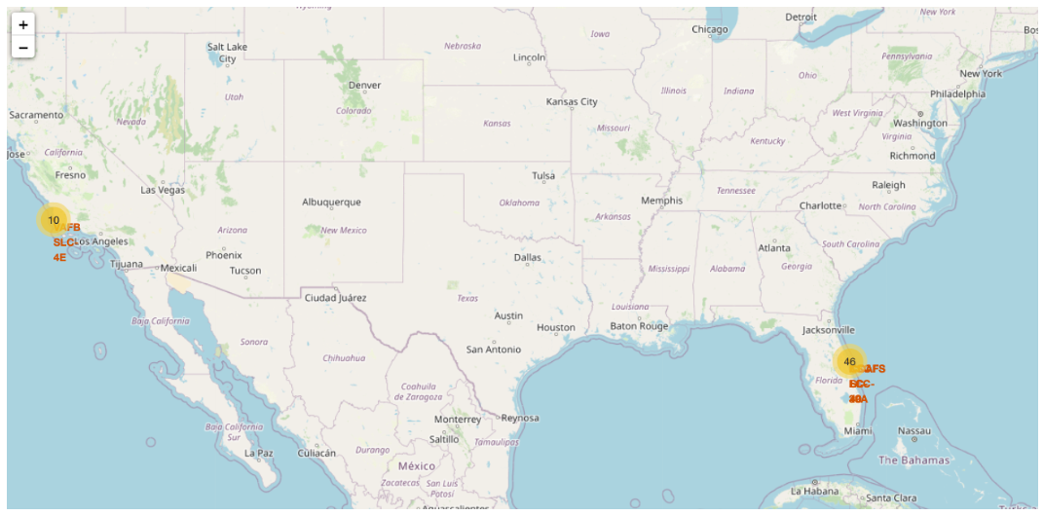
Build an Interactive Map with Folium
Data_Science_and_ML/lab_jupyter_launch_site_location.ipynb at main · UmerSherdil/Data_Science_and_ML (github.com)

Slide 14
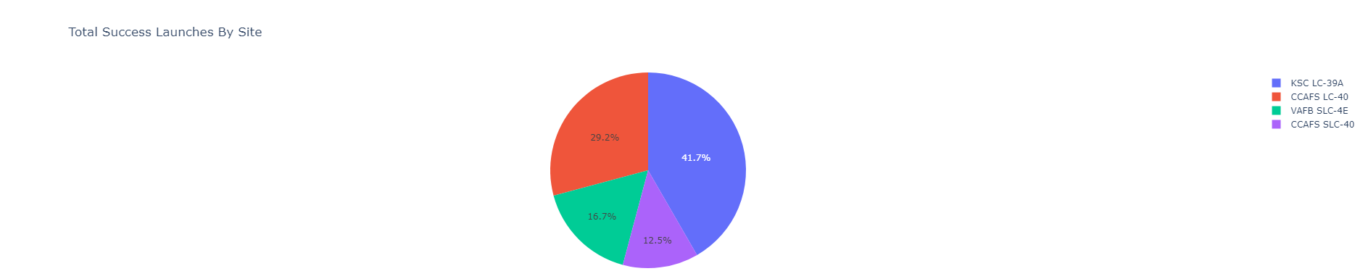
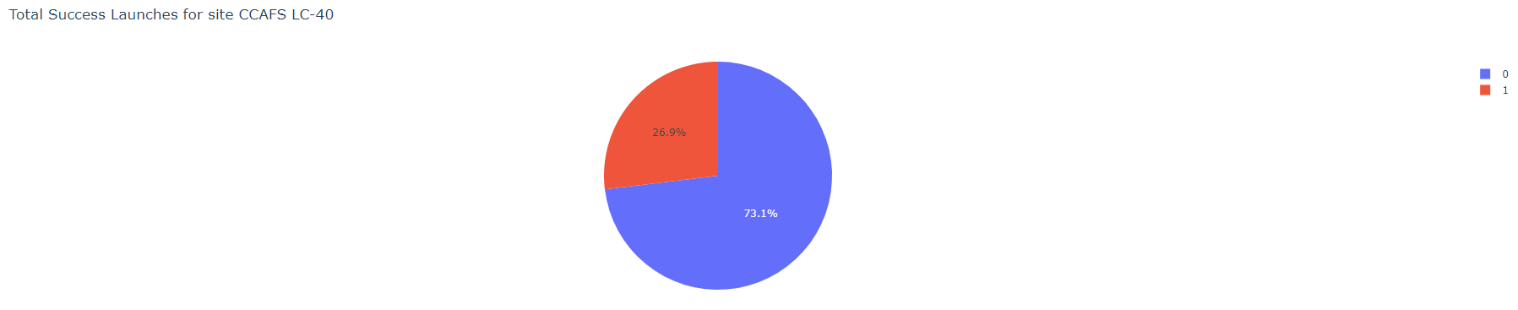
Build a Dashboard with Plotly Dash
Data_Science_and_ML/spacex_dash_app.py at main · UmerSherdil/Data_Science_and_ML (github.com)

Slide 15
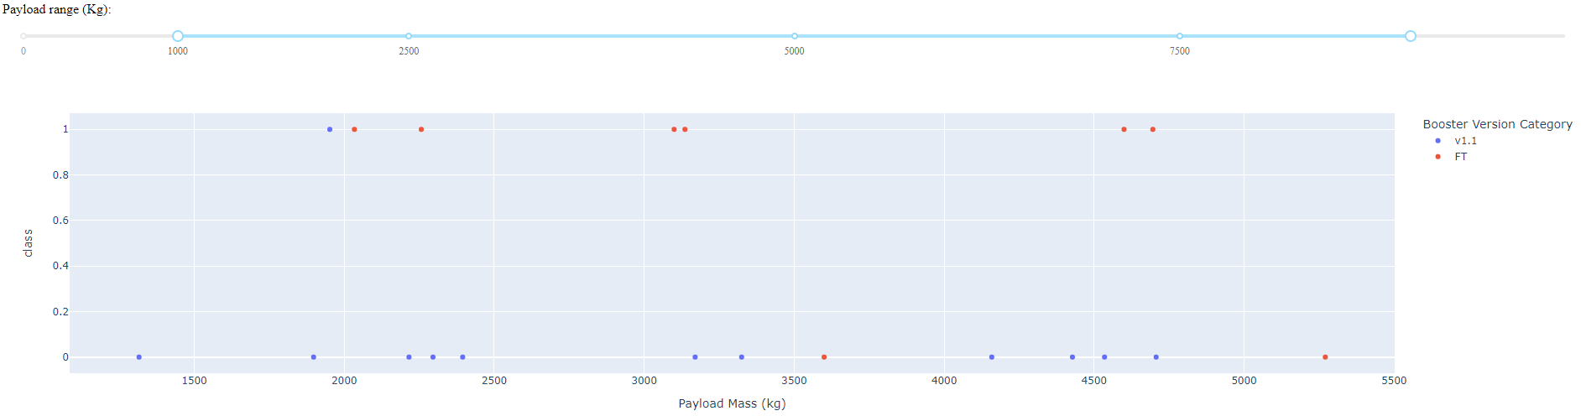
Build a Dashboard with Plotly Dash
Data_Science_and_ML/spacex_dash_app.py at main · UmerSherdil/Data_Science_and_ML (github.com)

Slide 16
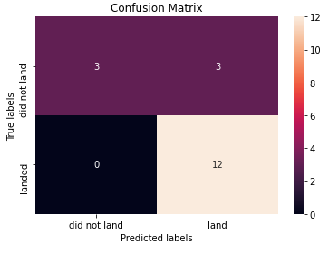

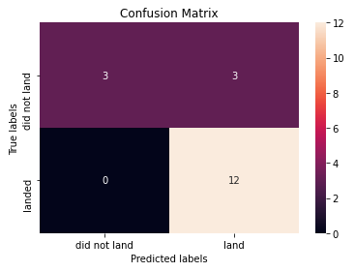
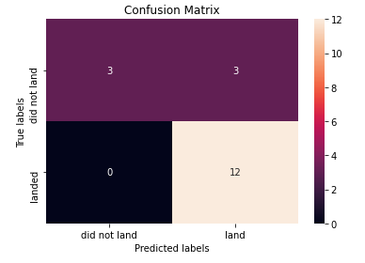
Predictive Analysis (Classification)
Logistic Regression
SVM
Decision tree performs best on test data (88.89% accuracy).
The accuracy of Logistic Regression, SVM and KNNs is 83.34%. (On test data).
Decision Tree
K-Nearest Neighbors (KNNs)
Data_Science_and_ML/SpaceX_Machine Learning Prediction_Part_5.ipynb at main · UmerSherdil/Data_Science_and_ML (github.com)

Slide 17
Results
The success rate of launches increases with years. This makes sense as with time SpaceX improves the rocket design.
KSC LC-39A launch site has the highest success rate.
Orbits ES L1, HEO, GEO and SSO have the highest success rates.
Decision tree performs best on test data with an accuracy of 88.89%.

Slide 18

Section 2

Slide 19
Flight Number vs. Launch Site
Most launches were made from CCAFS SLC 40 launch site.

Slide 20
Payload vs. Launch Site
Most lighter payloads were launched from CCAFS SLC 40.

Slide 21
Success Rate vs. Orbit Type
Orbits ES L1, HEO, GEO and SSO have the highest success rates.

Slide 22
Flight Number vs. Orbit Type
In the past more launches were made in LEO, ISS, PO and GTO orbit. However, with time the trend shifts towards VLEO orbit.

Slide 23
Payload vs. Orbit Type
Payloads between the range of 2000-4000 kg were mostly sent in ISS orbit; whereas, relatively heavier payloads (4000-8000 kg) were sent in the GTO orbit.

Slide 24
Launch Success Yearly Trend
Launch success rate increases significantly with time.

Slide 25
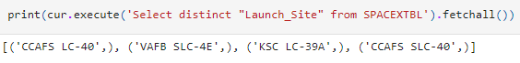
All Launch Site Names

Slide 26
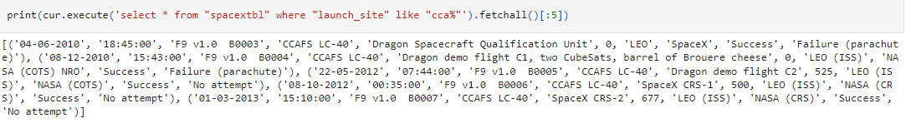
Launch Site Names Begin with 'CCA'

Slide 27
Total Payload Mass

Slide 28
Average Payload Mass by F9 v1.1

Slide 29
First Successful Ground Landing Date

Slide 30
Successful Drone Ship Landing with Payload between 4000 and 6000

Slide 31
Total Number of Successful and Failure Mission Outcomes

Slide 32
Boosters Carried Maximum Payload

Slide 33
2015 Launch Records

Slide 34
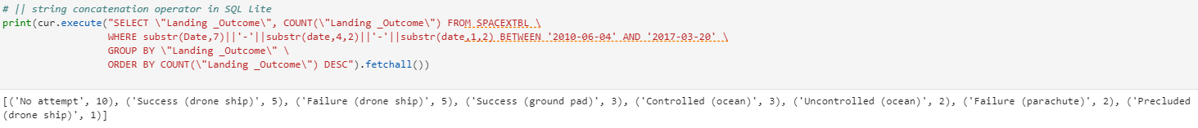
Rank Landing Outcomes Between 2010-06-04 and 2017-03-20

Slide 35

Section 3

Slide 36
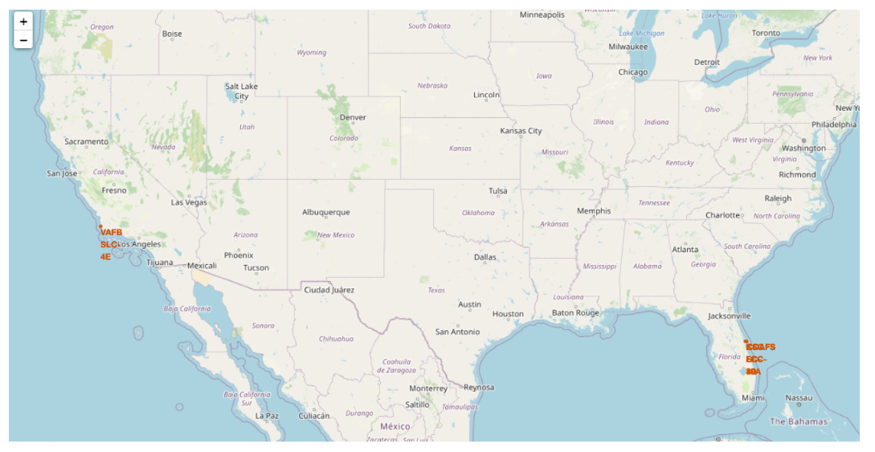
Location of all Launch Sites

Slide 37
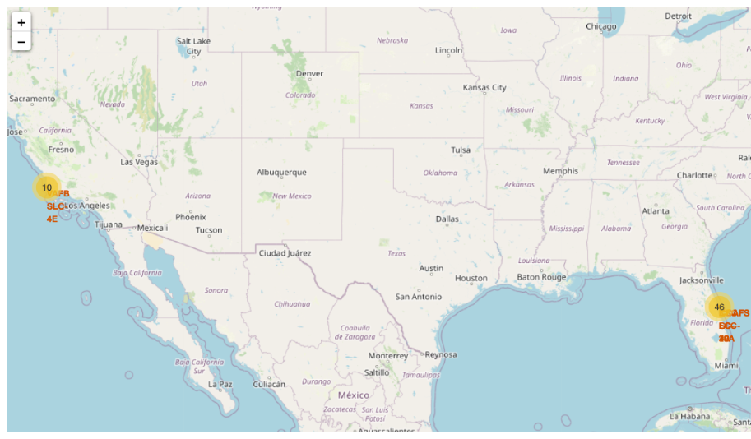
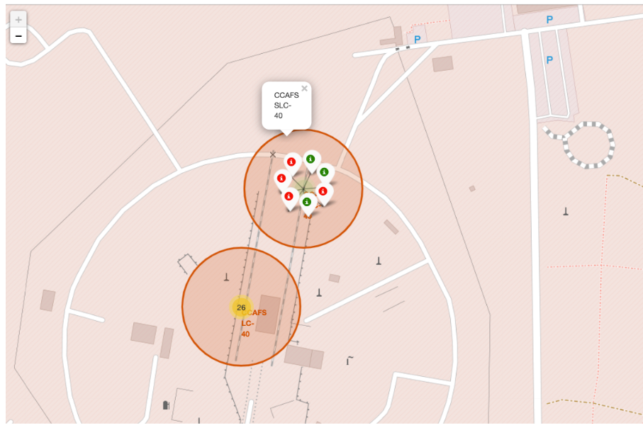
Success/Failed Launches

Slide 38
Distance between Launch Sites and its Proximities

Slide 39

Section 4

Slide 40
Success Rate of all Launch Sites
KSC LC-39A has the most successful launches from all sites.

Slide 41
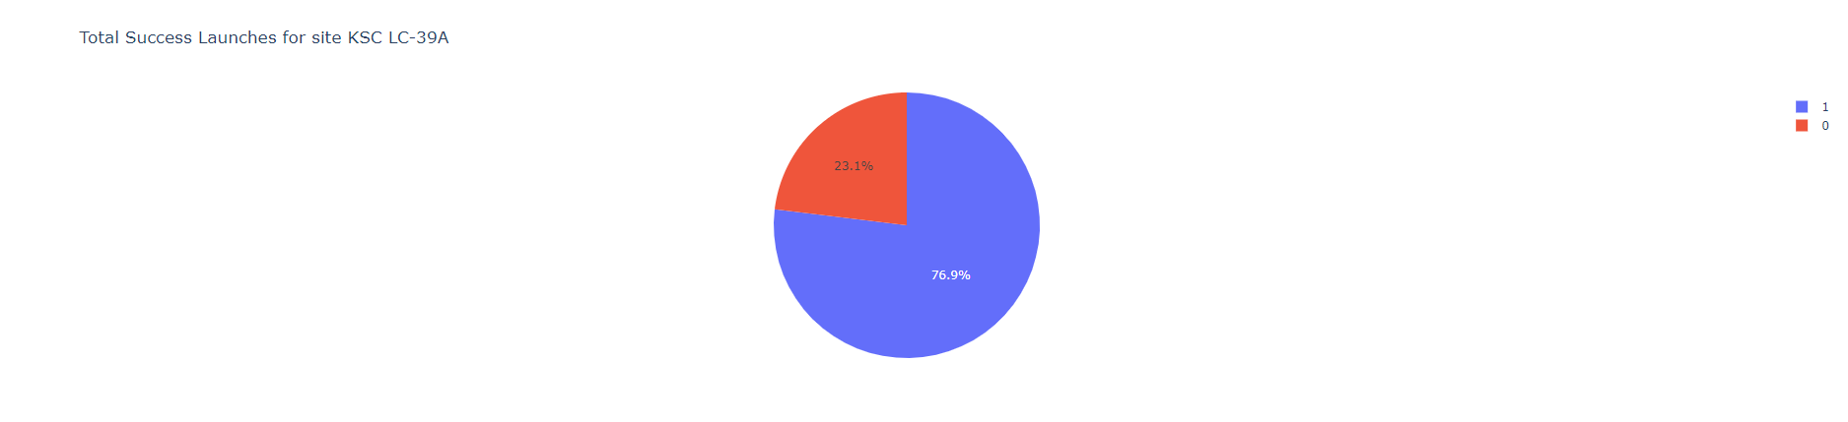
Success Rate of KSC LC-39A Launch Site

Slide 42
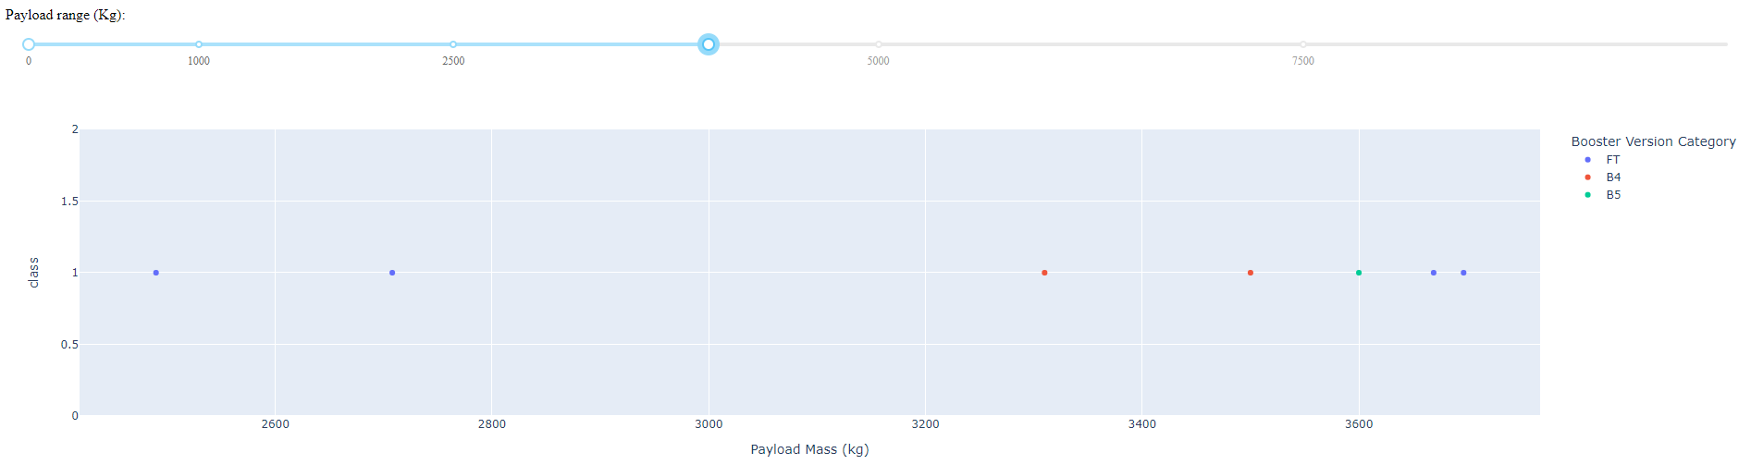
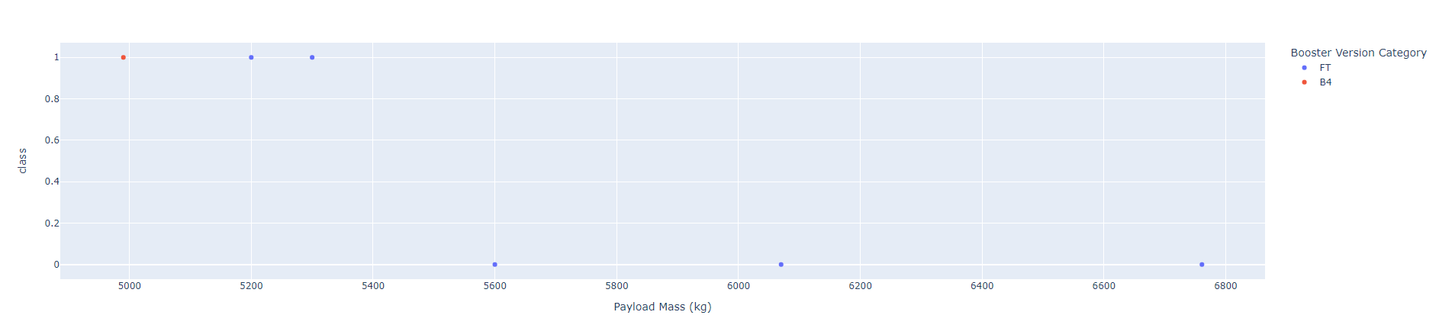
Success Rate and Payload Mass
The success rate of lighter payloads is higher than the heavier payloads.

Slide 43

Section 5

Slide 44
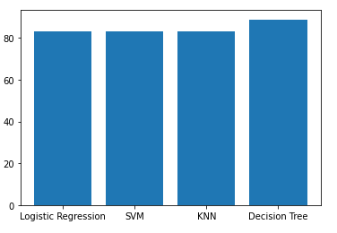
Classification Accuracy
Decision trees perform the best on test data.

Slide 45
Confusion Matrix
Logistic Regression
SVM
Decision Tree
K-Nearest Neighbors (KNNs)

Slide 46
Conclusions
The success rate of launches increases with years. This makes sense as with time SpaceX improves the rocket design.
KSC LC-39A launch site has the highest success rate.
Orbits ES L1, HEO, GEO and SSO have the highest success rates.
Ligher payloads perform better than heavier payloads.
Decision tree performs best on test data with an accuracy of 88.89%.

Slide 47


